Slide 1
JAVA PROJECT
E-Mail client software

Slide 2

Meet The Group
SAI HARSHITH TENNRI - AP21110010211
SRINIVAS PRADHAN - AP21110010220
GYANESH RAO - AP21110010239
GROUP - 01
ARADHY GARG - AP21110010241

Slide 3



INTRODUCTION
An email client is a computer program that you can be used to send, receive, and manage your emails. It helps you organize and access your emails from different email accounts in one place. Outlook and Thunderbird are examples of email clients.

Slide 4





ABSTRACT
Our advanced email client software revolutionizes the way you manage and interact with your email accounts.
With a user-friendly interface and a range of powerful features, our software consolidates multiple email accounts, intelligently filters messages, and offers customizable templates. It seamlessly integrates with productivity tools, ensures security, and is accessible across various platforms. Experience improved organization, enhanced productivity, and efficient communication with our email client software.

Slide 5




Tools and technology used:
IDE
NetBeans
Language
Java
Database
Text Files

Slide 6
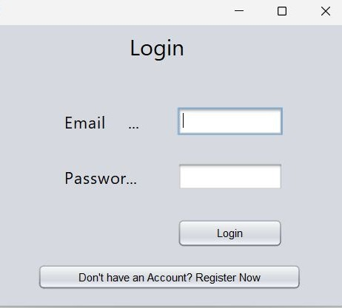
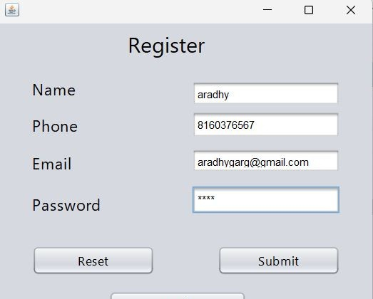
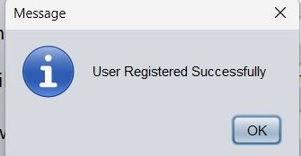
O U T P U T S

Slide 7
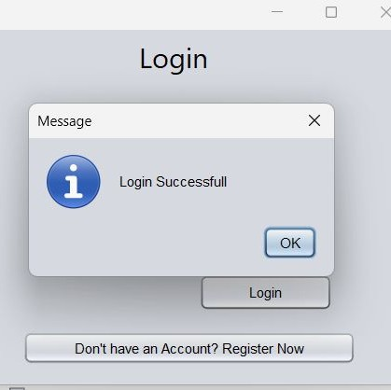
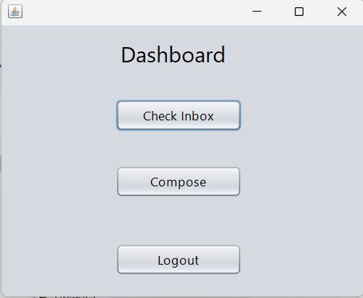

Slide 8
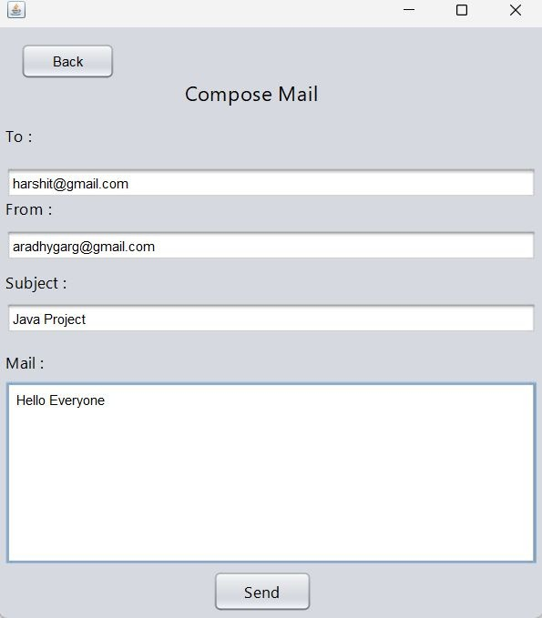
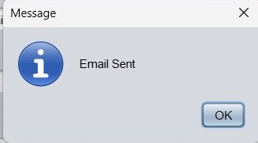

Slide 9
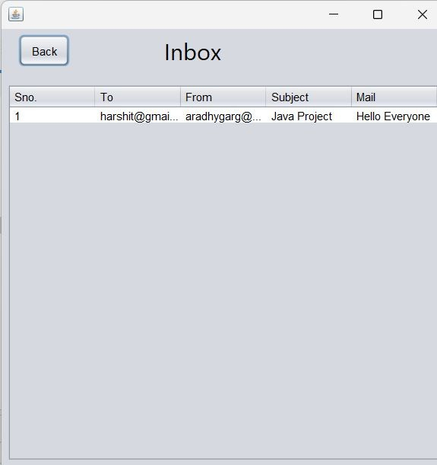
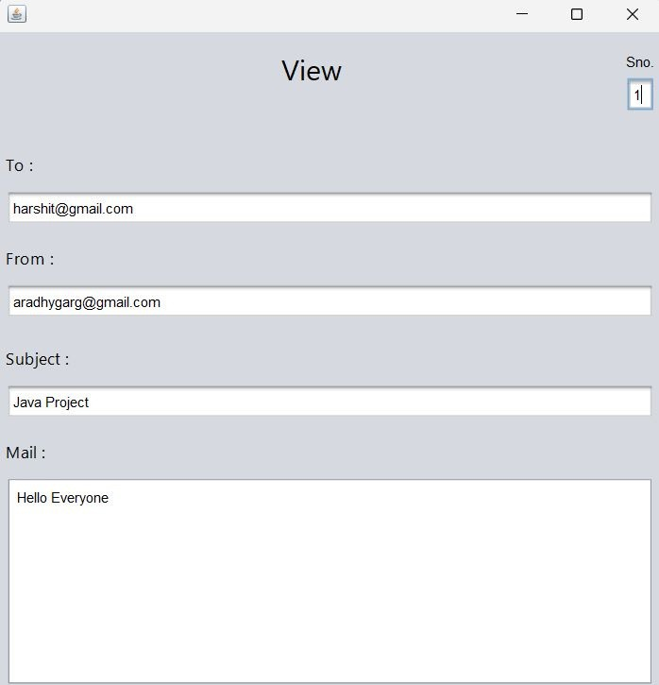

Slide 10




Conclusion
In conclusion, the Java-based email client software project successfully implements essential features for efficient email communication and management. It showcases the students' skills in Java programming, user interface design, network communication, and application testing. The software offers a user- friendly interface, supports multiple email protocols, and prioritizes security considerations. Overall, the project provides valuable learning experience and contributes to enhancing email communication.

Slide 11



Thank You

